Slide 1
UCSD Embedded C Assignment 3
By
Hsuankai Chang
hsuankac@umich.edu

Slide 2
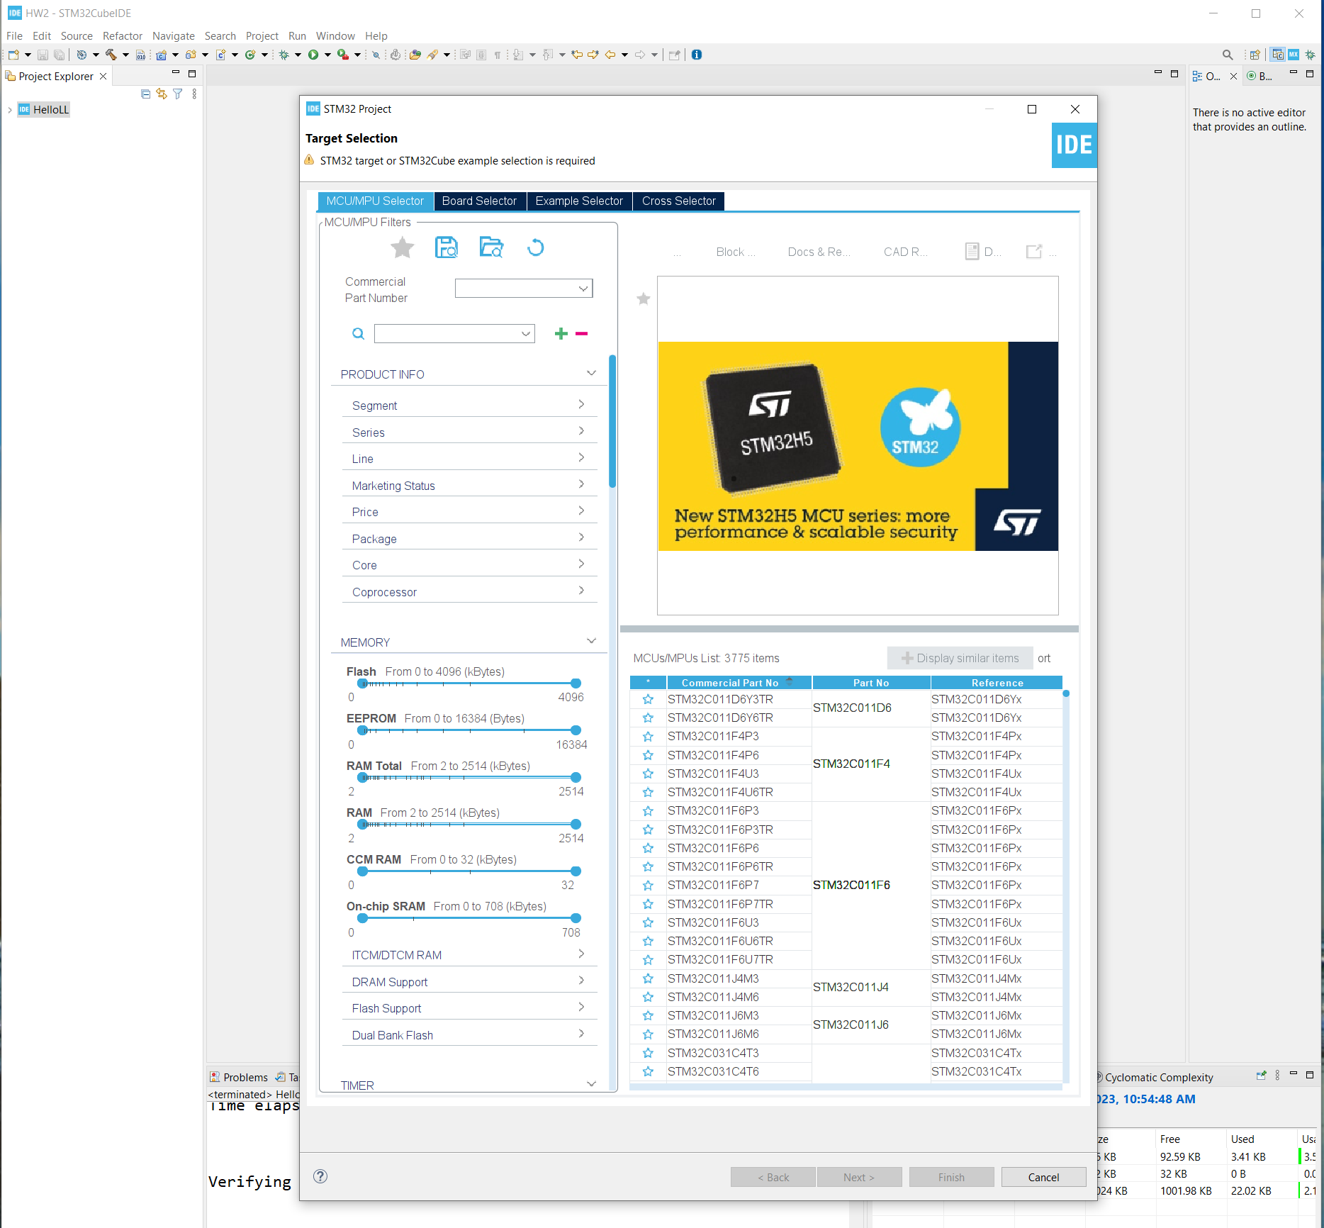
Step 1. Startup STM32CubeIDE and create new STM32 project

Slide 3
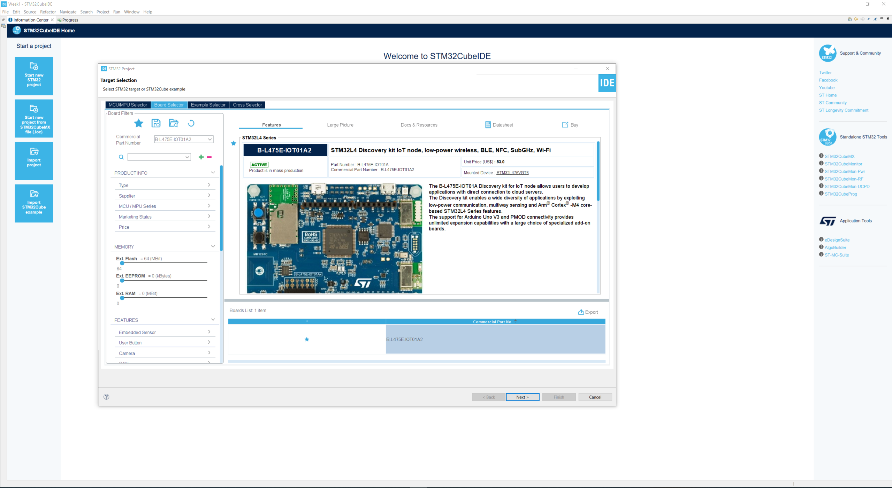
Step 2. Access board selector and type in the board you use, click Next

Slide 4
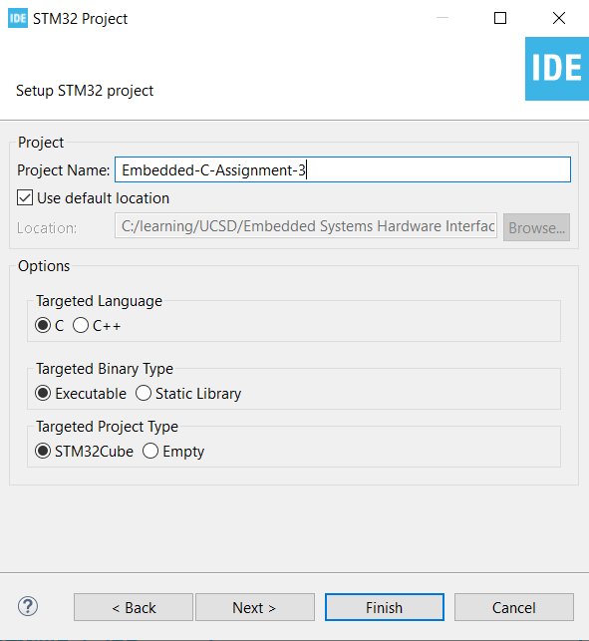
Step 3. Enter the project name then click Next

Slide 5
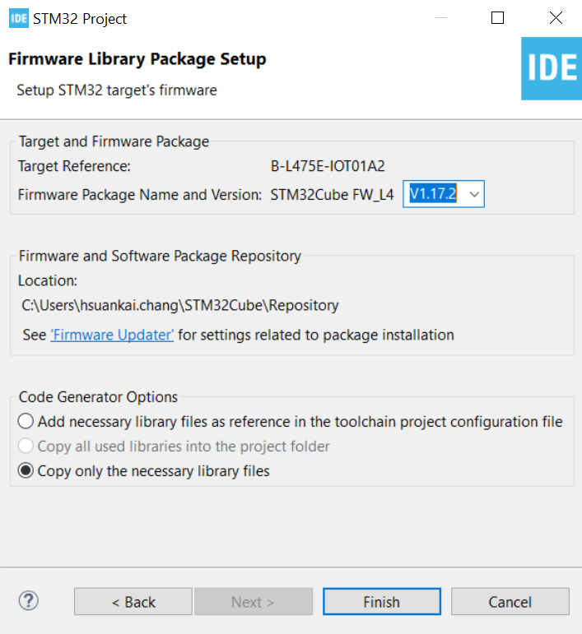
Step 4. See the firmware package name and version

Slide 6
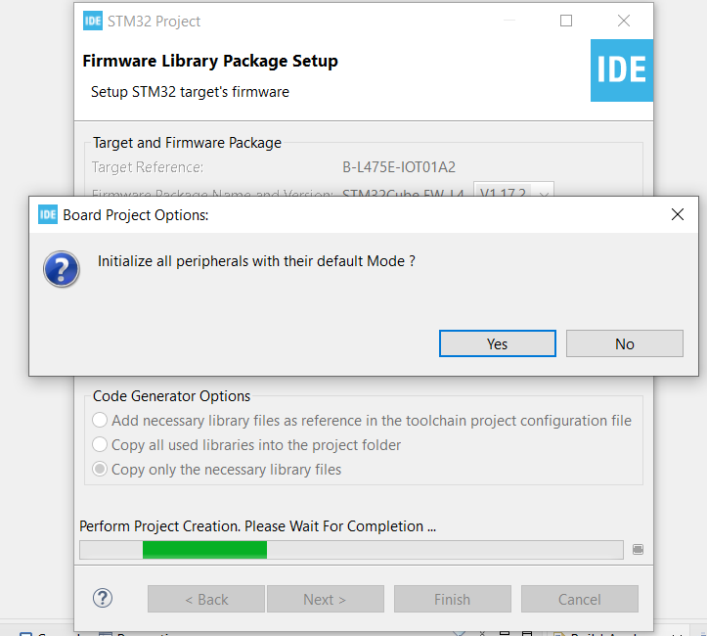
Step 5. Click yes to initialize all peripherals to default

Slide 7
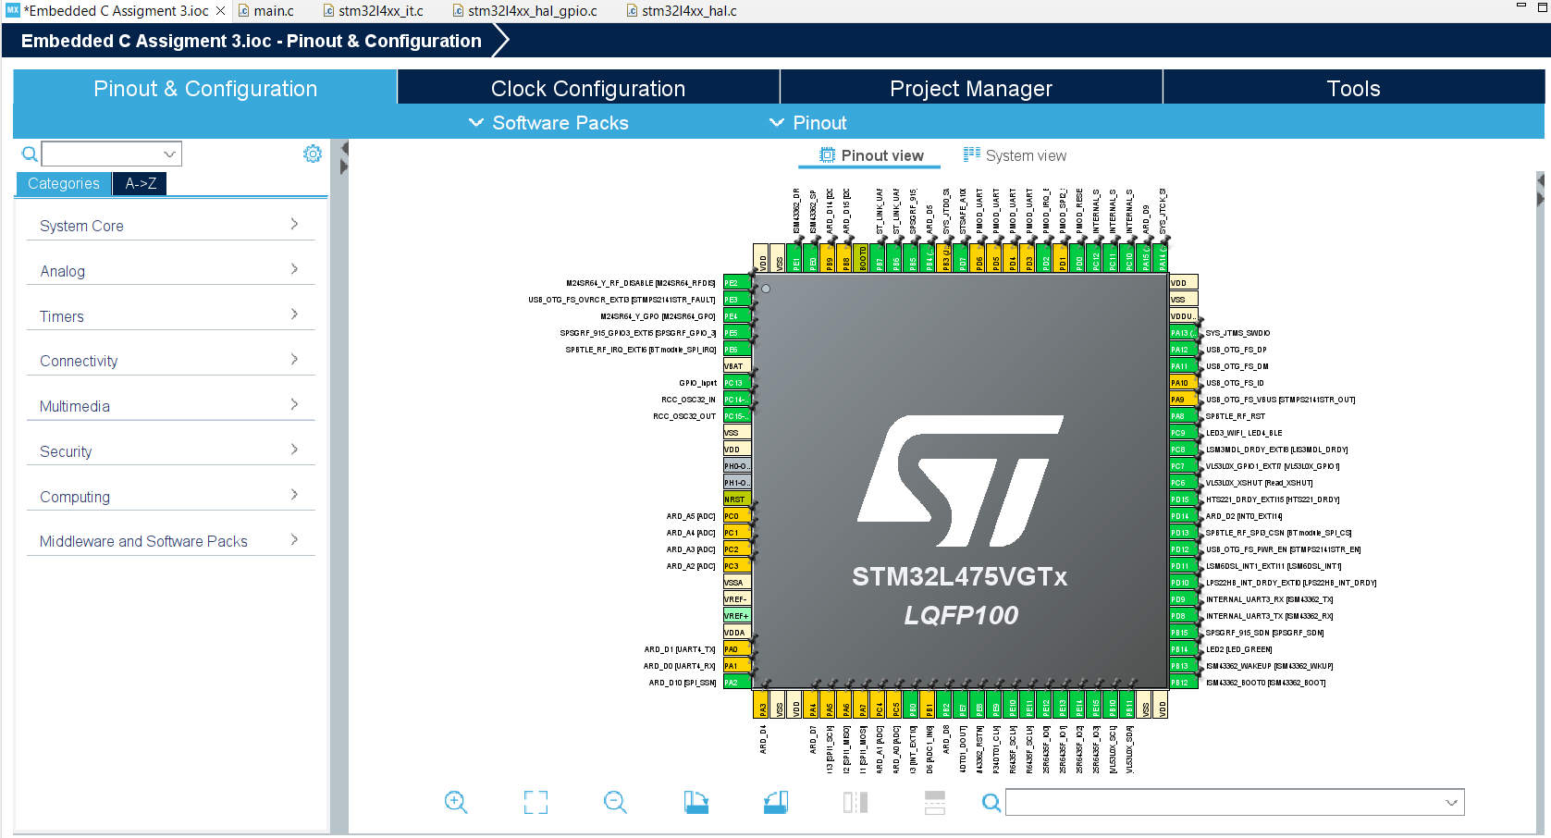
Step 6. When in .ioc file, click Pinout & Configurations

Slide 8
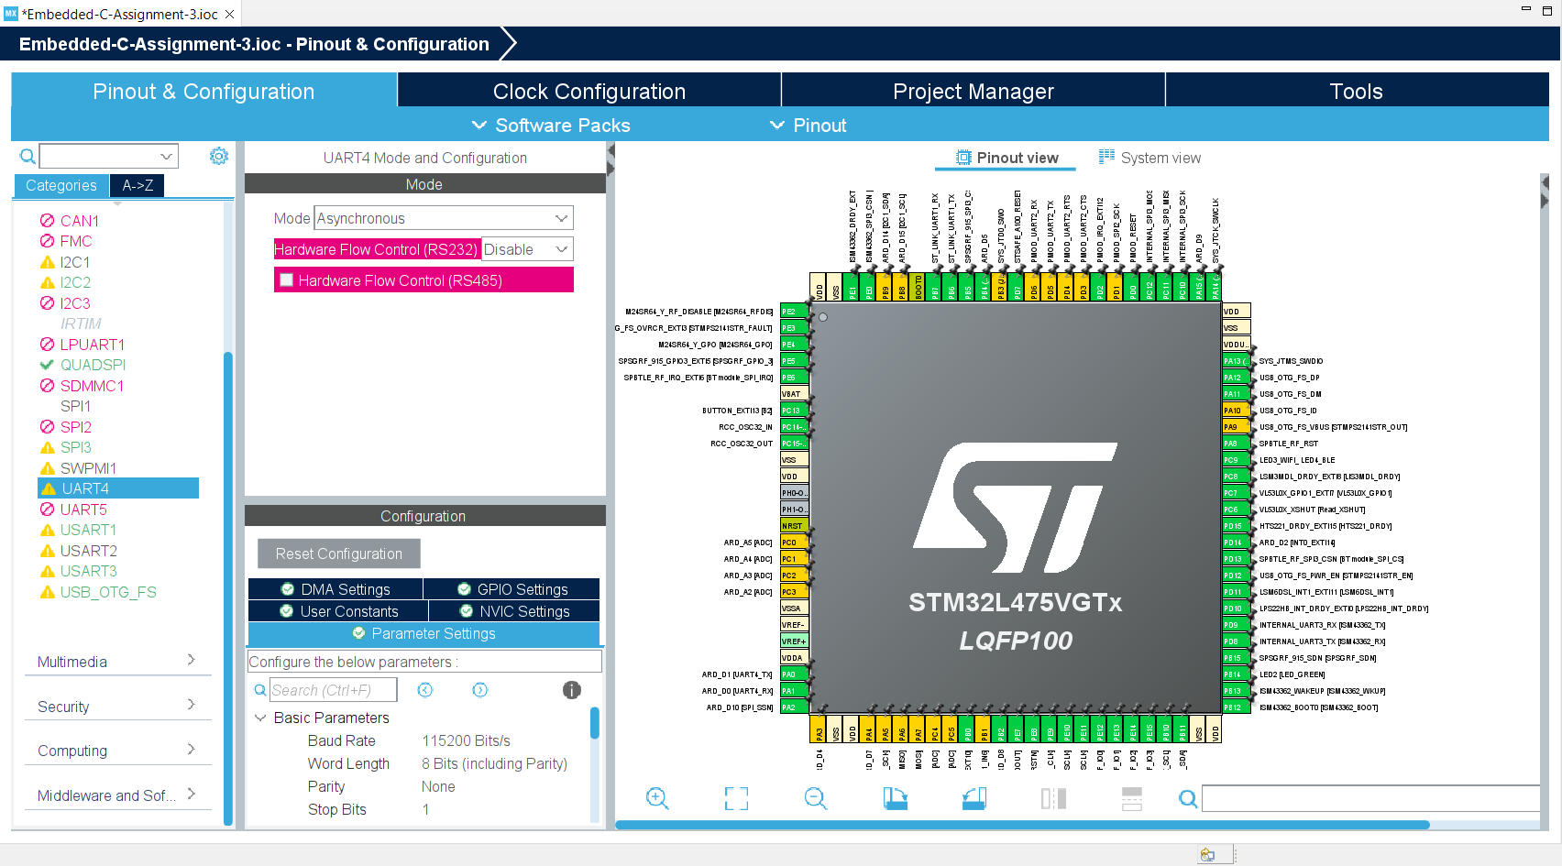
Step 7. User Story 1: Create a CLI (Command Line Interface) on UART1 that prompts you to enter a 1 for polling, a 2 for interrupt, and a 3 for DMA. Double check we have enabled USART1 and UART4

Slide 9
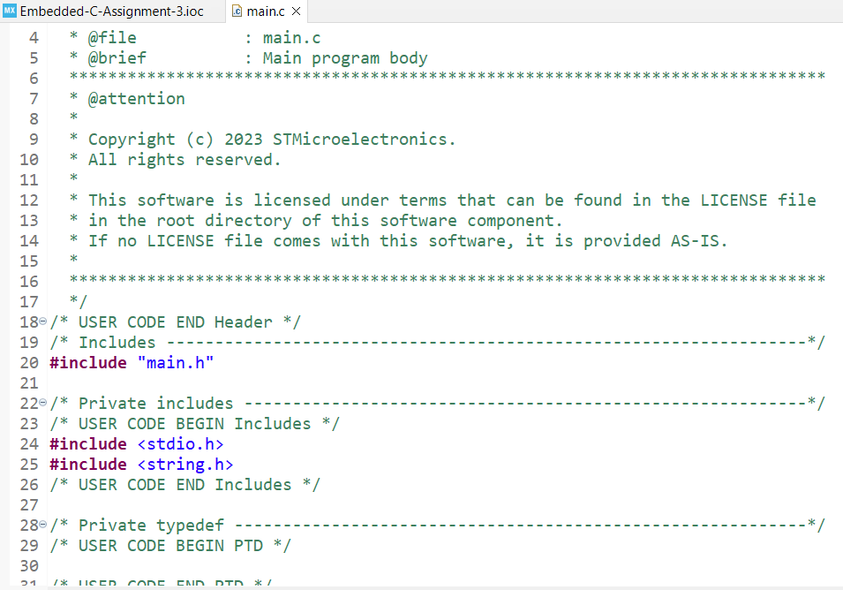
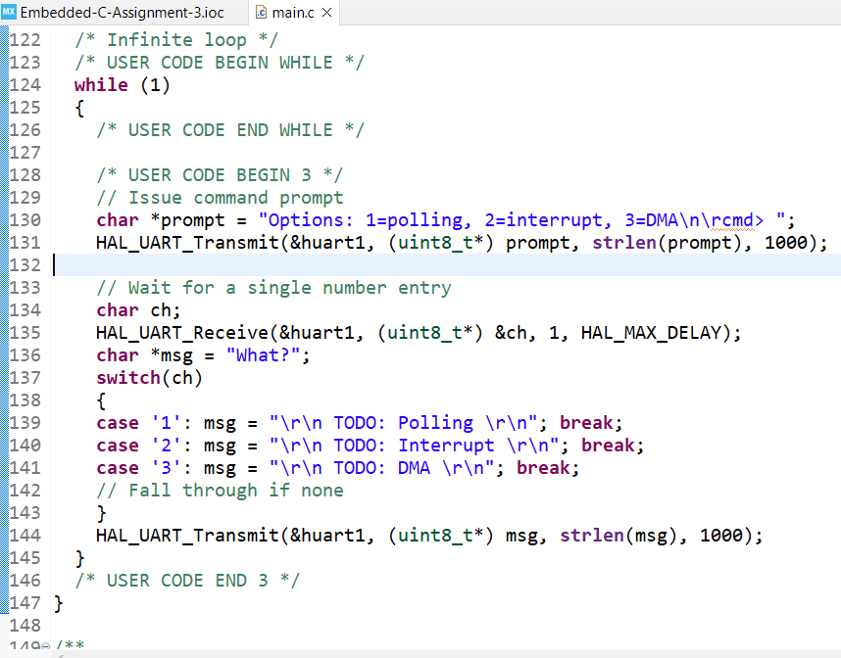
Step 8. User Story 1: Write the terminal code in main.c file

Slide 10
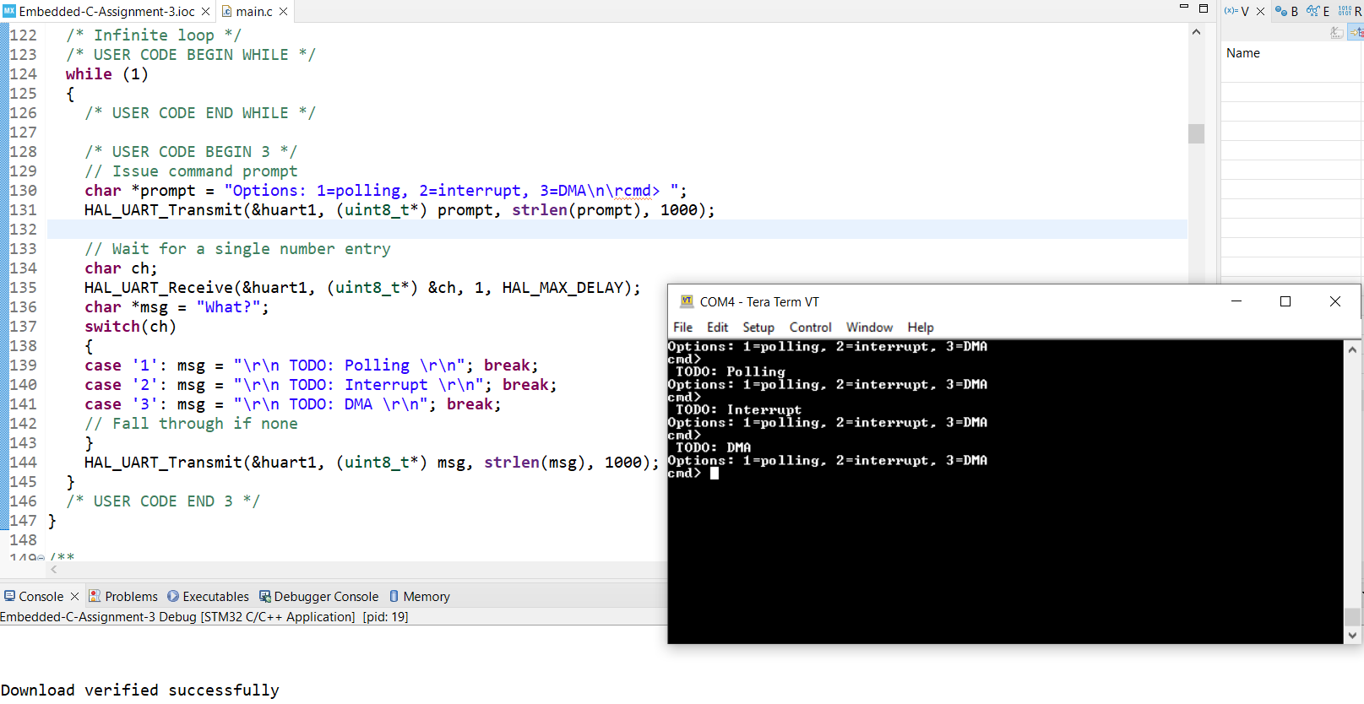
Step 9. User Story 1: Build and run in debug mode. Open tera term and test is successful

Slide 11
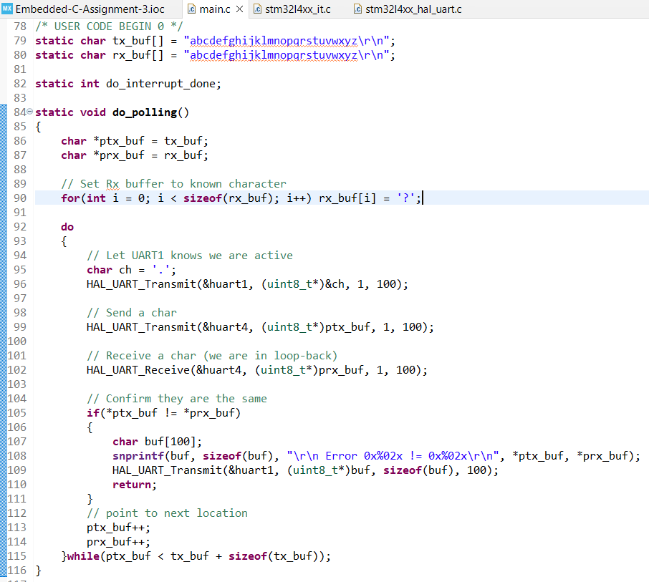
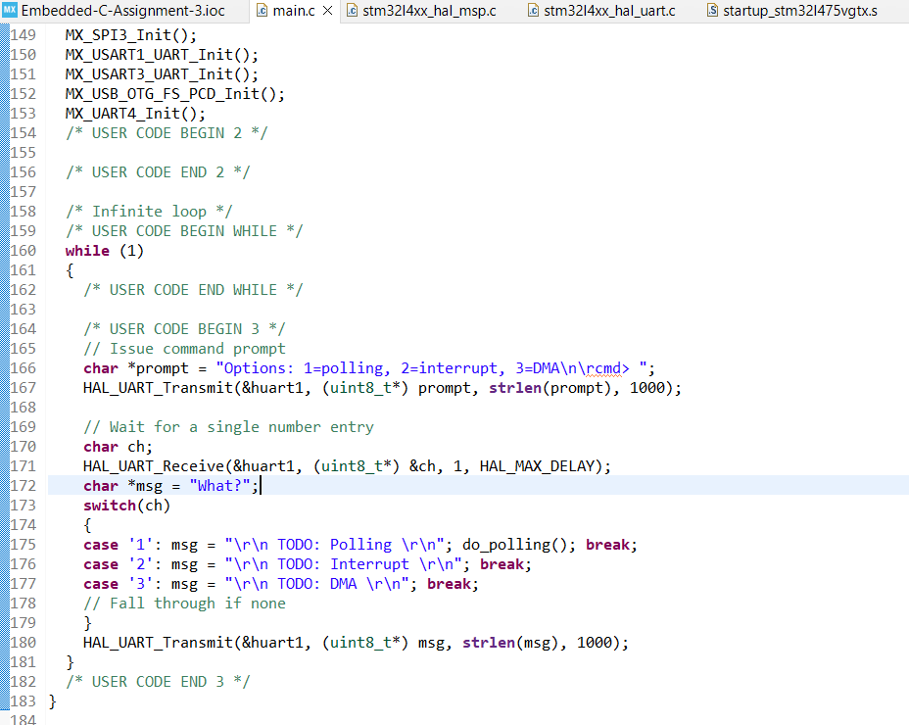
Step 10. User Story 2: Polling. When the user selects 1, use polling to transmit and receive the buffer. Write the code in main.c file

Slide 12
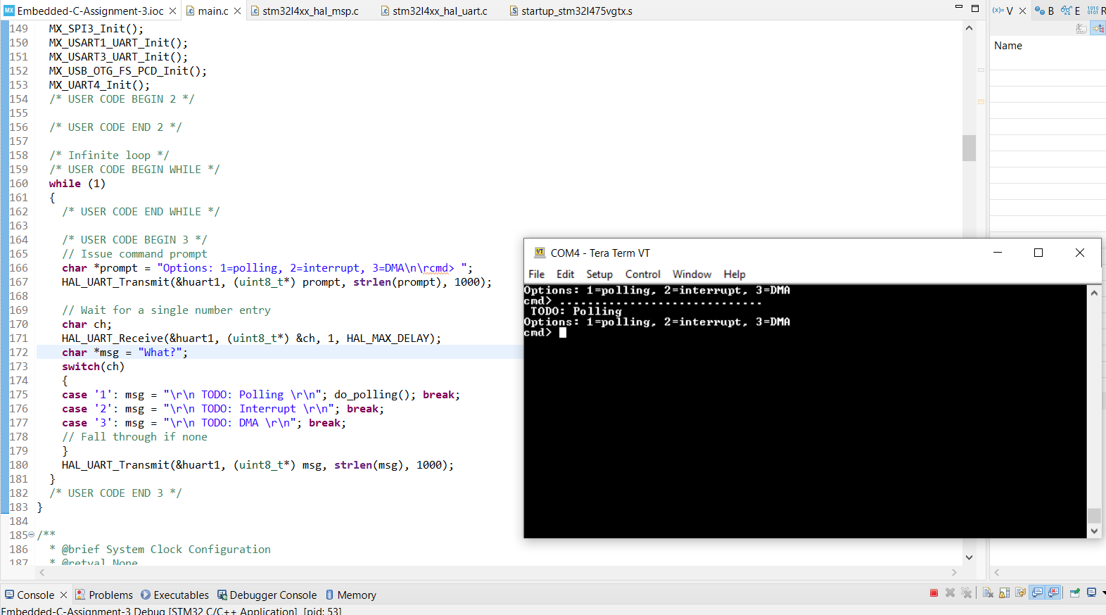
Step 11. User Story 2: Build and run the code, test is successful

Slide 13
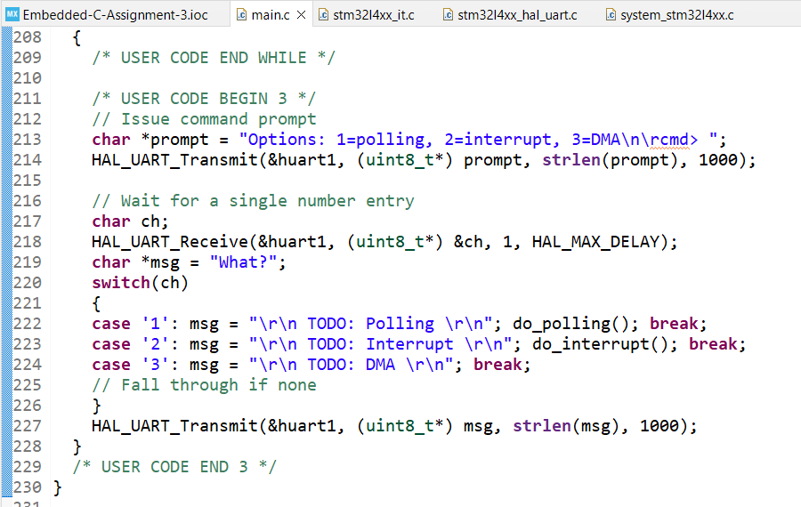
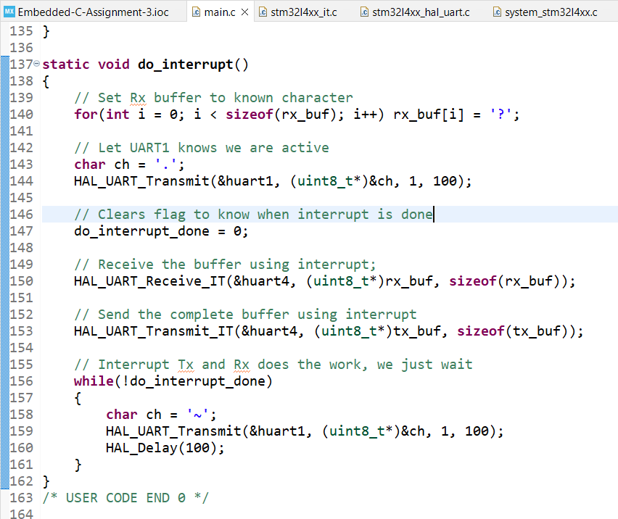
Step 12. User Story 3: Interrupts. When the user selects 2, use interrupts to transmit and receive the buffer. Write the code in main.c file

Slide 14
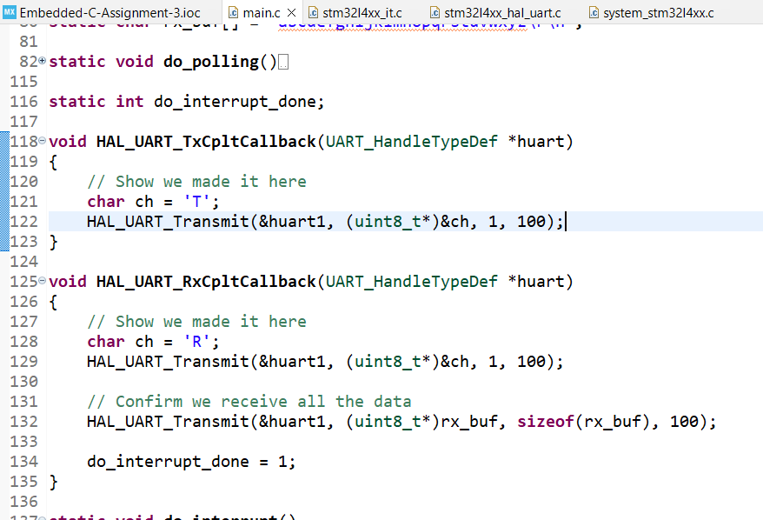
Step 13. User Story 3: Write the Rx and Tx complete call back functions

Slide 15
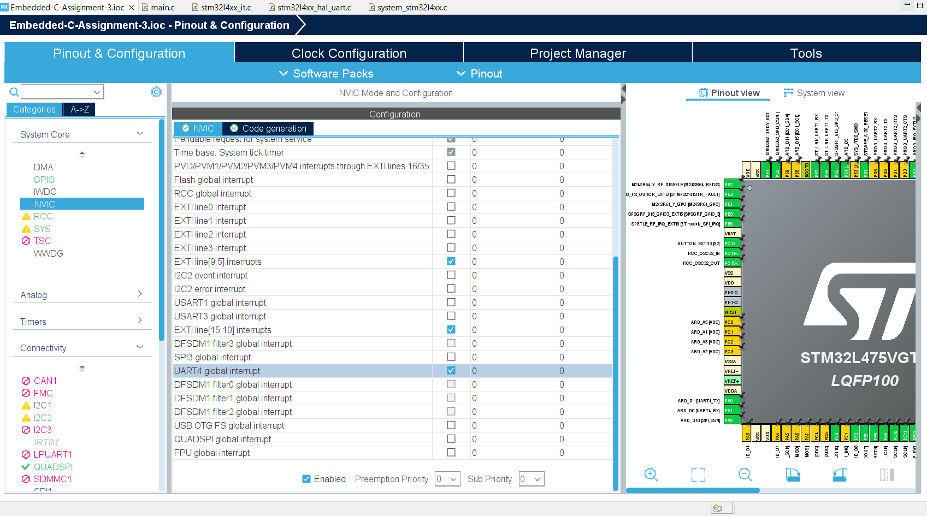
Step 14. User Story 3: Don’t forget to setup the NVIC

Slide 16
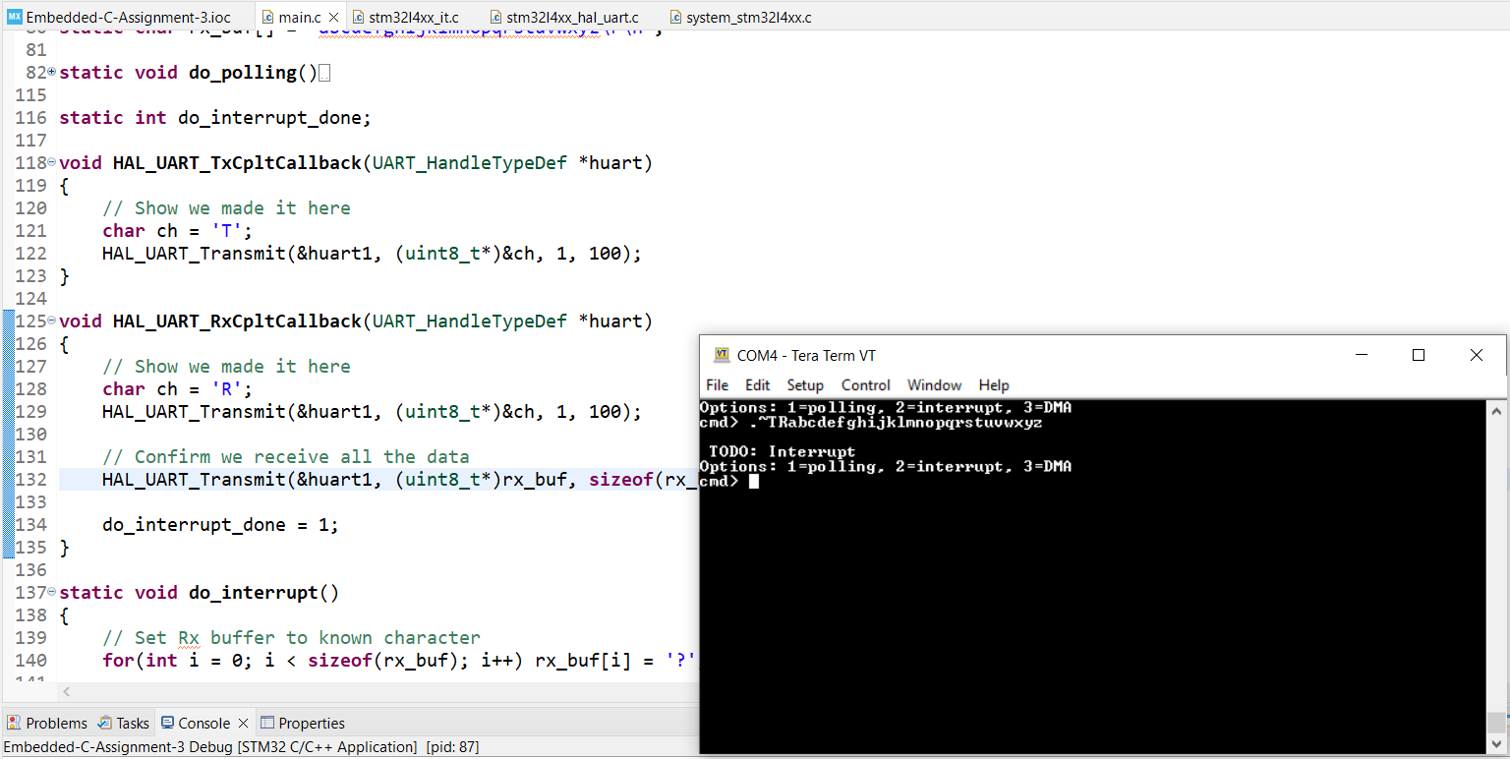
Step 15. User Story 3: Build and run the code, test is successful

Slide 17
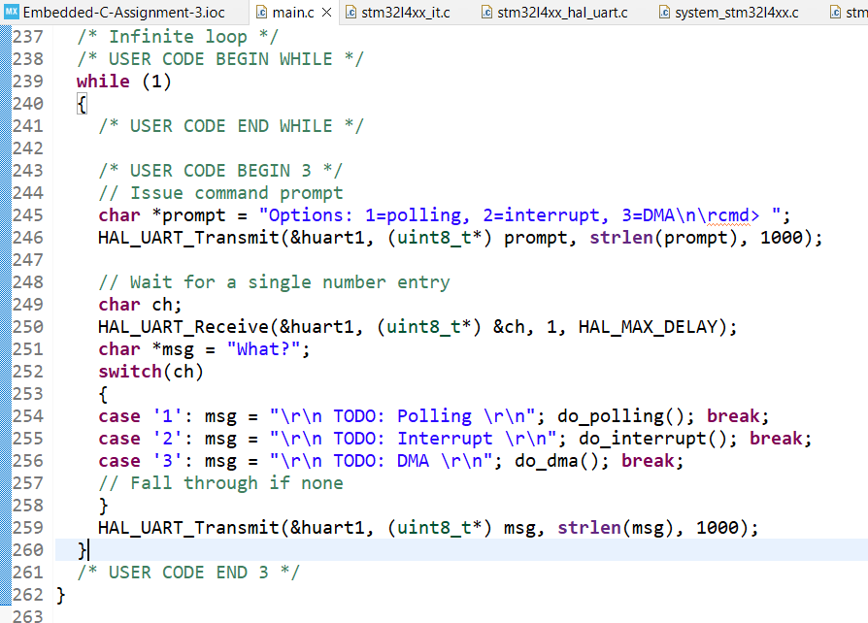
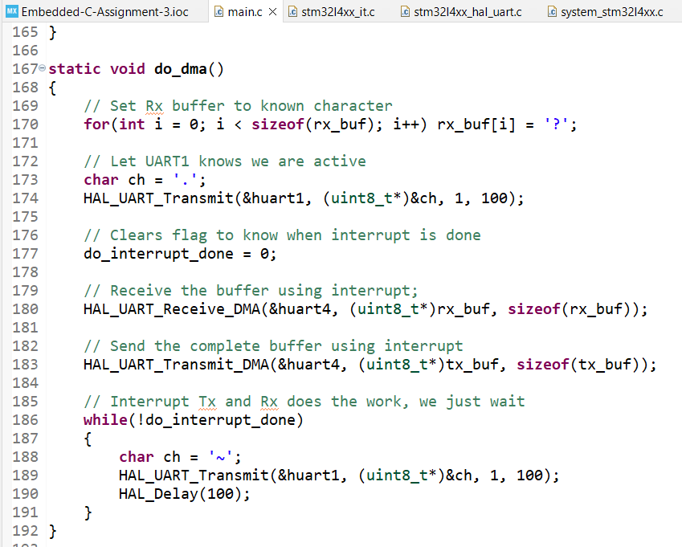
Step 16. User Story 4: DMA. When the user selects 3, use DMA to transmit and receive the buffer. Write the code in main.c file

Slide 18
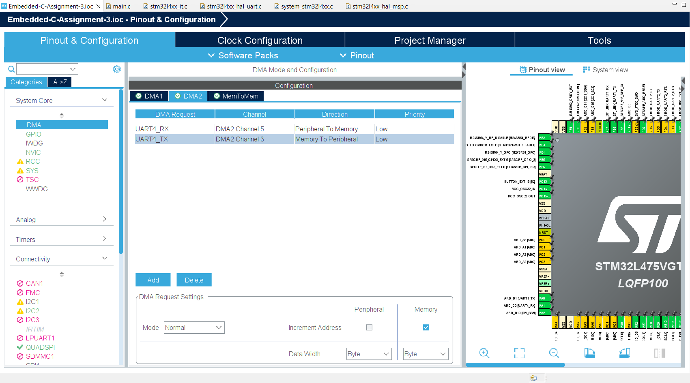
Step 17. User Story 4: Setup the DMA in .ioc file

Slide 19
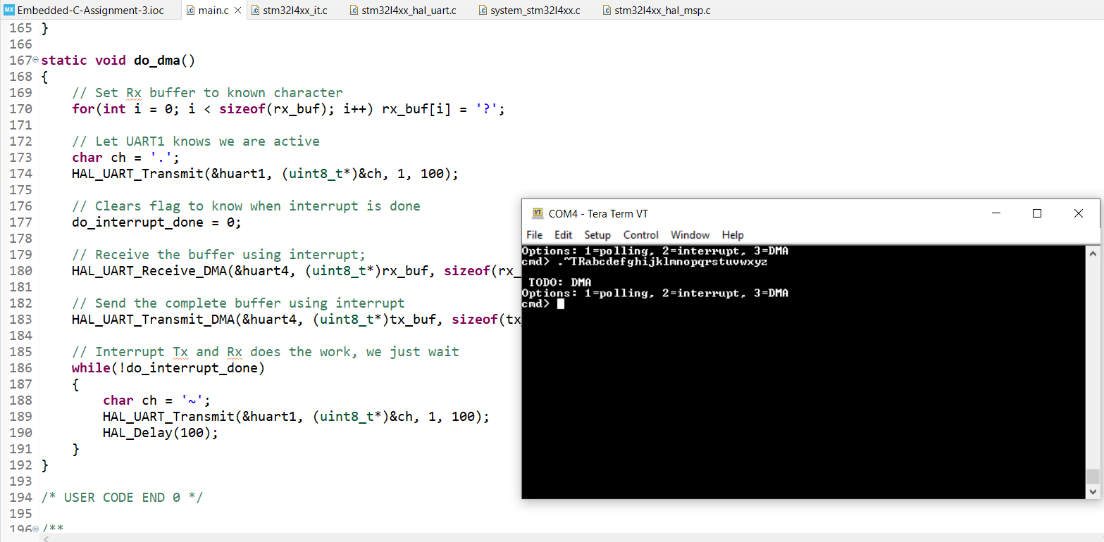
Step 18. User Story 4: Build and run the code, test is successful. Since DMA mode will call the same Tx and Rx call back functions, we do not need to code it up again

Slide 20
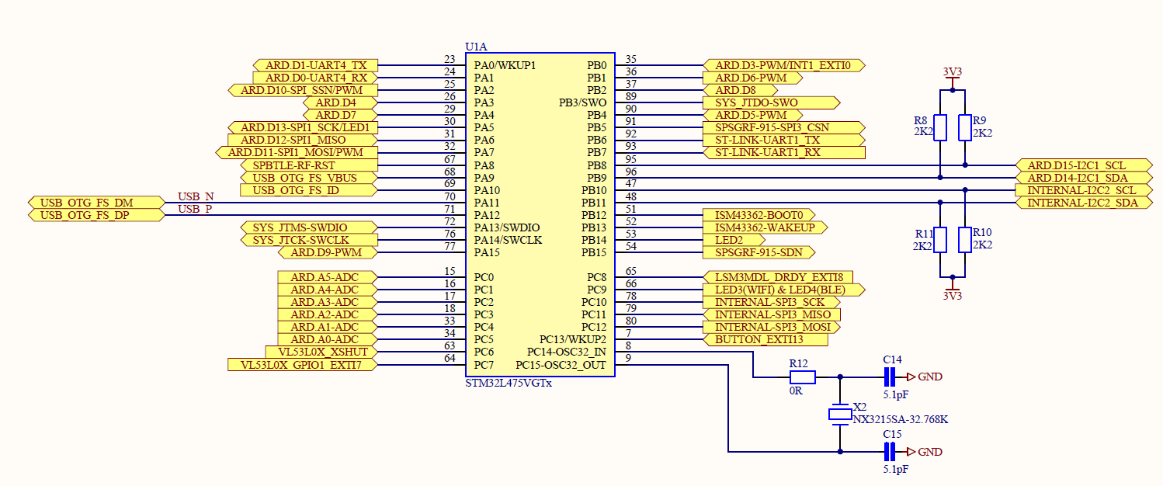
Appendix. Screenshot of STM32 Discovery Kit Schematic diagram where it shows the UART1 and UART4 signals

Slide 21
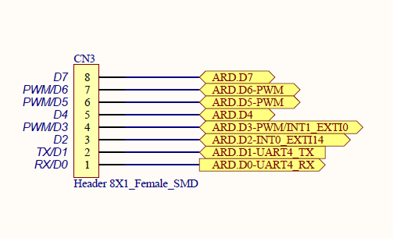
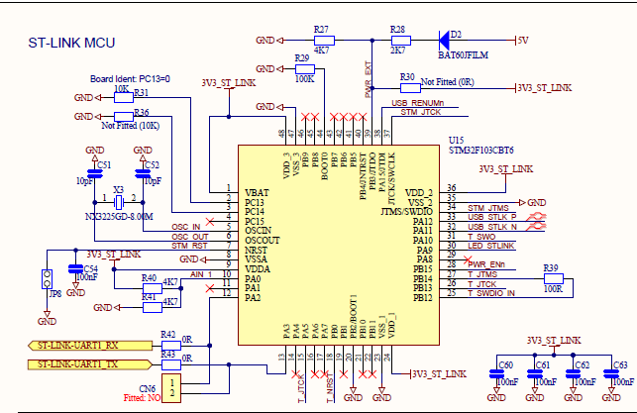
Appendix. Screenshot of STM32 Discovery Kit Schematic diagram where it shows the UART1 and UART4 signals

